Slide 1

Face Recognition in Navigating Humanoids using CNN and PCA - Literature review

Slide 2
1.
INTRODUCTION

Slide 3
Deep learning for Computer Vision:
Object Detection
Motion tracking
Action recognition
Human pose estimation
Semantic segmentation

Slide 4
What we shall Discuss…
The Layers of a CNN
Image Pre-Processing using Histogram Equalization
Convolutional Neural Networks
Application of CNN in Face Recognition
Face Recognition Sytsem using PCA
Conclusion
Comparison of CNNs vs DBNs vs DBMs vs SdAs in Visual Imagery
Google’s FaceNet
Facebook’s DeepFace
OpenFace
Face Detection
Face Alignment
Facial Features Extracting
Face Matching
Comapring their accuracy

Slide 5
Convolutional Neural Network (CNN)
Artificial Neural Networking Model common used for analysing Visual Imagery

Slide 6
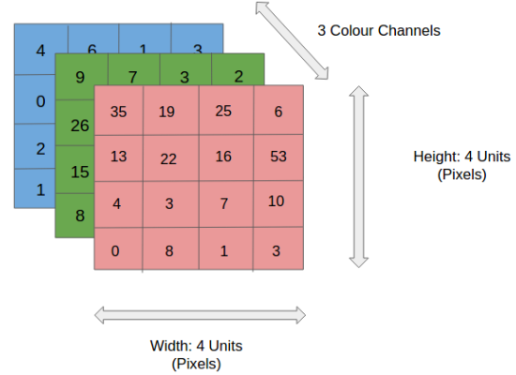
Steps to train a cnn for classification of an image
Separating the Channels
Grayscale, RGB, HSV, etc.
Split into the maximum possible number of channels
Convolving the Kernel
A kernel matrix of size nxn performs dot operation sliding across the m x m pixel matrix i.e., the image by a stride length
Types of Convolving
Same Padding: Convolving results in a matrix with the same dimensions as image
Valid Padding: Convolving results in a matrix with the same dimensions as kernel

Slide 7
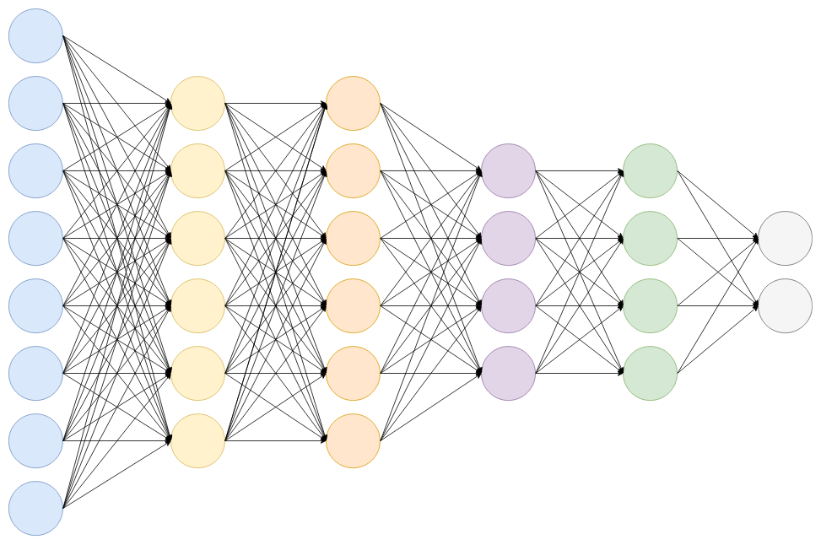
Steps to train a cnn for classification of an image
Pooling
Reduces spatial dimensions without manipulating the depth using:
Max Pooling or
Average Pooling
Classification at the Fully Connected Layer
The matrix resulted after various convolution and pooling operations, will then be flattened and classified. Training with numerous labelled datasets will eventually gain accuracy in classifying the input images.

Slide 8
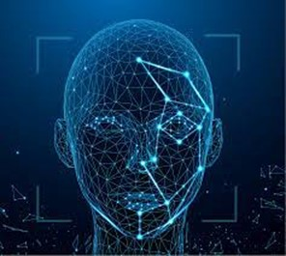
cnn in face recognition
Merits
Feature Learning
Transformation Invariance
Already Implemented by
Google’s FaceNet
Facebook’s DeepFace
OpenFace (open source)

Slide 9
Principal Component Analysis (PCA)
Standard technique used in statistical pattern recognition and signal processing for data reduction and extraction features

Slide 10
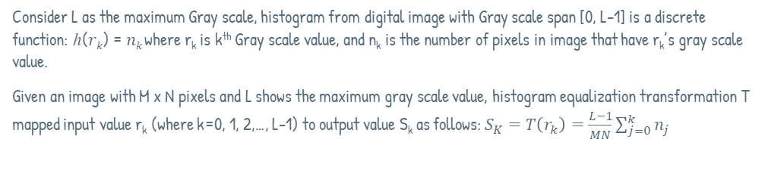
Steps to train a machine using pca for face recognition
Convert all the face images into gray scale images
Convert the face images given for training into gray scale images to eliminate the presence of multiple channels
Image Preprocessing using Histogram Equalization
Histogram equalization is a method to improve lighting in an image processing by adjusting its contrast using the image's histogram. The areas with lower local contrast can gain a higher contrast in this way
Consider L as the maximum Gray scale, histogram from digital image with Gray scale span [0, L-1] is a discrete function: ℎ(𝑟_{𝑘}) = 𝑛_{𝑘} where r_{k} is k^{th} Gray scale value, and n_{k} is the number of pixels in image that have r_{k}’s gray scale value.
Given an image with M x N pixels and L shows the maximum gray scale value, histogram equalization transformation T mapped input value r_{k} (where k=0, 1, 2,…, L-1) to output value S_{k} as follows:$S_{K}=T\left(r_{k}\right)=\frac{L−1}{MN}\sum_{j=0}^{k}{n_{j}}$

Slide 11
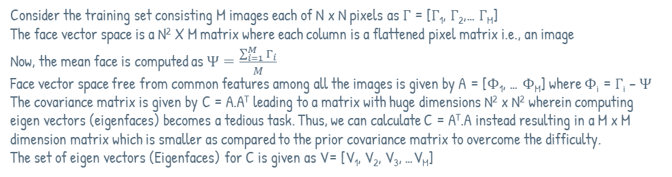
Steps to train a machine using pca for face recognition
Convert the face images in the training set to face vectors
Arrange the flattened pixel matrix of each image column wise to obtain the face vector space
Normalize the face vectors
Calculate average face vector
Subtract the average face vector from each face vector
Compute the Eigenfaces
Eigenfaces are the eigen vectors of the covariance matrix C. They are usually computed in lower dimensional subspaces and converted back to the original dimensionality for ease of computation
Consider the training set consisting M images each of N x N pixels as Γ = [Γ₁, Γ₂,… Γ_{M}]
The face vector space is a N² X M matrix where each column is a flattened pixel matrix i.e., an image
Now, the mean face is computed as $Ψ=\frac{\sum_{i=1}^{M}{Γ_{i}}}{M}$
Face vector space free from common features among all the images is given by A = [Φ₁, … Φ_{M}] where Φ_{i} = Γ_{i} – Ψ
The covariance matrix is given by C = A.A^{T} leading to a matrix with huge dimensions N² x N² wherein computing eigen vectors (eigenfaces) becomes a tedious task. Thus, we can calculate C = A^{T}.A instead resulting in a M x M dimension matrix which is smaller as compared to the prior covariance matrix to overcome the difficulty.
The set of eigen vectors (Eigenfaces) for C is given as V= [V₁, V₂, V₃, …V_{M}]

Slide 12
Steps to train a machine using pca for face recognition
Pick the Best Eigen faces
Select K best eigenfaces from the eigen space U such that K < M whuch can represent the whole training set. How best we choose effect how efficient the recognizing system is trained.
Lower Dimensionality to the Original Dimensionality
Multiply each of the K vectors picked with the matrix A to convert it back to the original dimensionality.
Compute the weight matrix of an eigenface
Representing each of the M images in Γ as a linear combination of the K eigenfaces plus the mean face Ψ, the column vectors of corresponding scalars used is the weight matrix of that image.
After picking the best K eigen vectors from V, convert them back to the original dimensionality by multiplying them with A. Thus, the eigen space in the original dimensionality will be U = [U₁, U₂, U₃, …U_{k}].
Thus, dimensionality reduction helped in ease of computation of eigen faces as well as to reduce the effective noise.
Now, a face vector can be given as Γ_{i} = ω₁(U₁) + ω₂(U₂) + … + ω_{k}(U_{k}) + Ψ. The scalars ω₁, ω₂, …,ω_{k} here are known as weights. The column vector 𝛺_{i} = [𝜔₁, 𝜔₂, … 𝜔_{k} ]^{𝑇} is known as the weight matrix of image Γ_{i}.

Slide 13
Recognizing an unknown face by the pca
Convert the Input image to a gray scale image
Improve the lighting using Histogram Equalization
Convert the input image to a face vector
Normalize the face vector
Project the normalized face vector onto the eigen space
Compute the weight vector of the input image
Calculate the Euclidian distance between this weight vector and the weight vectors of each of the faces already trained.
The eigen face with which the Euclidian distance is minimum is of the person whose face is provided.

Slide 14
CONCLUSION

Slide 15
Thanks!
Any questions?

Slide 16
Papers/Articles reviewed:
Christian Tarunajaya1 , Oey Kevin Wijaya1 , Reinard Lazuardi Kuwandy1 , Heri Ngarianto1 , Alexander A S Gunawan1 , and Widodo Budiharto1, IPTEK, The Journal for Technology and Science, Vol. 26, No. 2, August 2015 Development of Intelligent Humanoid Robot with Face Recognition Features
Deep Learning for Computer Vision: A Brief Review, HindAwi, Volume 2018 |Article ID 7068349

Slide 17
Team Presentation
K V Krishna Paanchajanya 19BCS063, V SEM
Karthik Sajjan
19BCS049, V SEM
Karusala Deepak Chowdary
19BCS050, V SEM

